Slide 1

Strategic design
&
Context Mapping

Slide 2
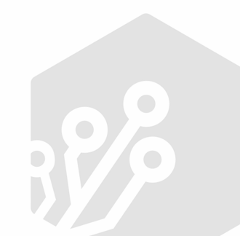
DDD in legacy
Eric Evans article form 2013: GETTING STARTED WITH DDD WHEN SURROUNDED BY LEGACY SYSTEMS
Main ideas:
Bubble context & Repository-Backed ACL
Try DDD with lower risk
Autonomous Bubble & Synchronizing ACL
More ambitious strategy

Slide 3
DDD in legacy
Legacy
Legacy
new model
new model
Acl Repo
Legacy DB
Legacy DB
New DB
Acl Sync

Slide 4
DDD legacy strategy
How to select the model for the bubble context?
Looking at the past
Your code as a crime scene by Adam Tornhill
Software design X-rays by Adam Tornhill
Looking at the future
Understand business directions to find candidates models for the bubble

Slide 5
Strategic design
it is a pillar of the DDD whose main objective is to define the Bounded contexts, the Ubiquitous Language and the Context Maps together with the entire project team, which are the domain experts and the technical team.

Slide 6
Strategic design
When: Is not an analysis phase at the beginning of the project. Strategy evolves with the software and organization.
Who: Everyone in the project, from domain experts to technical staff. Strategic design is more about collaboration than about design.
How: Through collaboration to build a shared vision of the strategy. there are some useful artifacts to reflect this shared vision like context maps, event storming of a glossary of terms for the UL.

Slide 7
Bounded Contexts
Is a logical boundary. Defines tangible boundaries to protect the integrity of the model within.
Has associated a Ubiquitous language.
The same term can have different meanings in different BC’s

Slide 8
Bounded Contexts
DELIVERY
PAYMENT
PRODUCT
Size
Weight
Stock
….
PRODUCT
Price
Discounts
...

Slide 9
Context mapping
A context map capture the technical and organizational relationship between various bounded contexts.
Is a high level, hand drawn diagram that communicates and holistic view of the contexts in play. Should be simple enough to be understood by domain experts and the technical team.

Slide 10
Context mapping
Is extremely important that the context map reflect reality showing the code in the current state rather than an ideal future state.
Reflect clearly the core domain or domains.

Slide 11
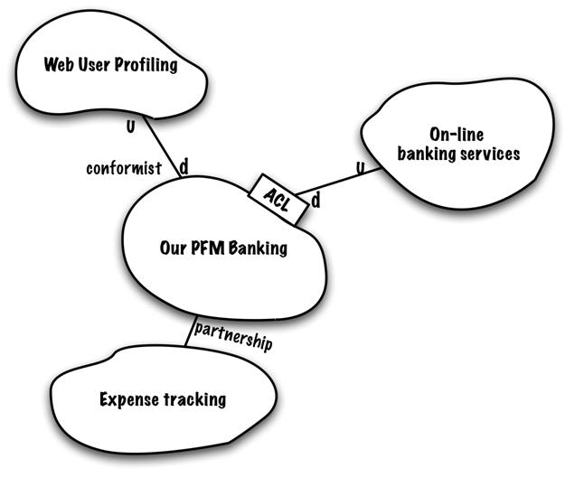
Context mapping

Slide 12
Relationships: Shared kernel
Gestion
Riesgos
Atención
Cliente
Hipoteca
Gestion Riesgos
Atención Cliente
Hipoteca
Shared Kernel

Slide 13
Relationships: Anti corruption layer
Optimización de Rutas
Distancias
(third party)
ACL

Slide 14
Relationships:
Open Hub/Published Language
Listado Anuncios
Importación de anuncios
OHS/PL
Ofertas

Slide 15
Relationships: Partnership
IMPORTACIÓN PRODUCTOS
LISTADOS DE PRODUCTOS
PARTNERSHIP

Slide 16
Relationships: Upstream/downstream
Downstream context depends on upstream context, and can be affected by changes of the upstream. This can refer to technical or organizational dependencies.
Customer/Supplier
Conformist

Slide 17
Relationships: Upstream/downstream
Customer/Supplier: the supplier exposes some kind of interface and the customer depends on that interface.
Flat Listings
Stats
U
D

Slide 18
Relationships: Upstream/downstream
Conformist: Is a special case when the consumer/downstream context cannot ask for changes in the upstream. Typical case with generic or third party contexts.
Members
Registration
CRM
(Third Party)
U
D
Conformist

Slide 19
Context mapping examples
Gestión ambulancias
Red social financiera

Slide 20
Context mapping
Ensure that everyone can access and understand the context map: use information radiators.
Very useful for onboarding new members to the organization
Update to reflect changes, technical and organizational

Slide 21
Exercise
In groups of 2 or 3 people try to build a context map to tell us your system organization. At the end one member of each group expose the resulting diagram to the class. Remember to:
Reflect reality not a ideal future state
Define your BC and use the relationships we discussed previously
Indicate clearly the core domain(s)
Notes:
Habra que proporcionales una herramienta para que puedan hacerlo, miro mismo.

Slide 22
Other Crunching knowledge tools
Impact mapping
Model Exploration Whirlpool
Agile inception

